Slide 1
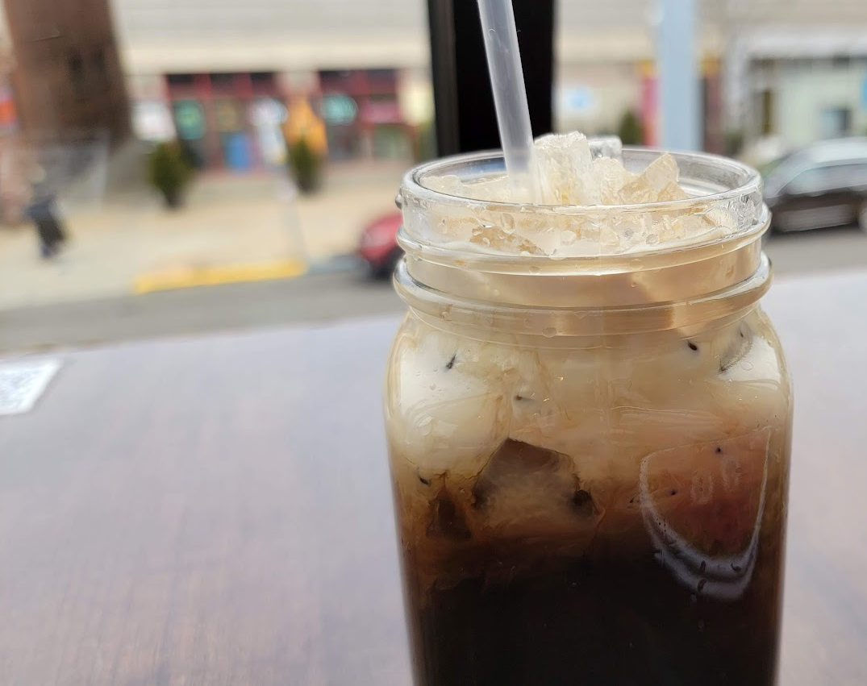
COVID19 and restaurant’s closure in Pittsburgh
A GIS analysis for restaurant’s owners
Korawich Kavee
kkavee@andrew.cmu.edu

Slide 2
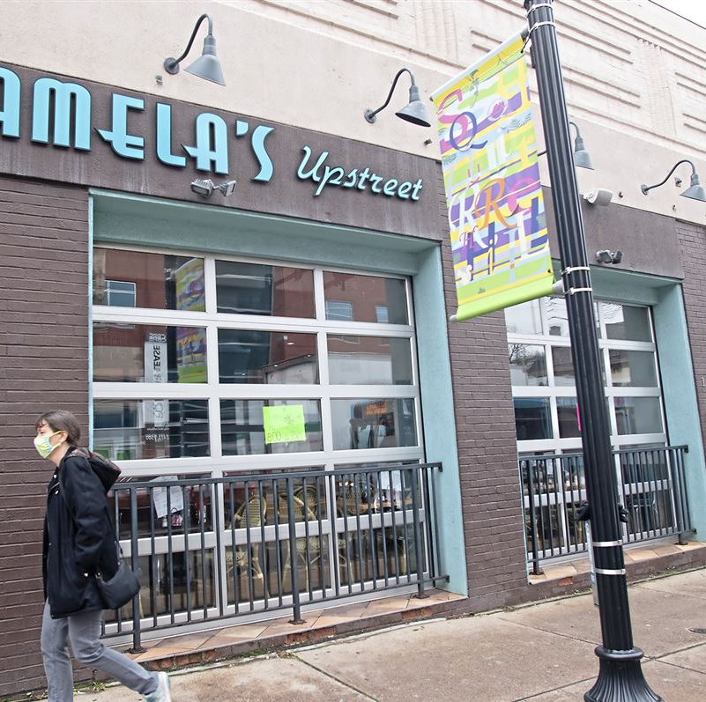
Background
Work-From-Home (WFH) policy, COVID-19 lockdowns
loss of revenue
Some examples
Pamela’s Diner in Squirrel Hill (Close)
Eat'n Park in Squirrel Hill (Close)
Roundabout Brewery in Lawrenceville (To-go)
Notes:
https://www.post-gazette.com/life/dining/2021/12/29/pamelas-diner-closing-squirrel-hill/stories/202112290134

Slide 3
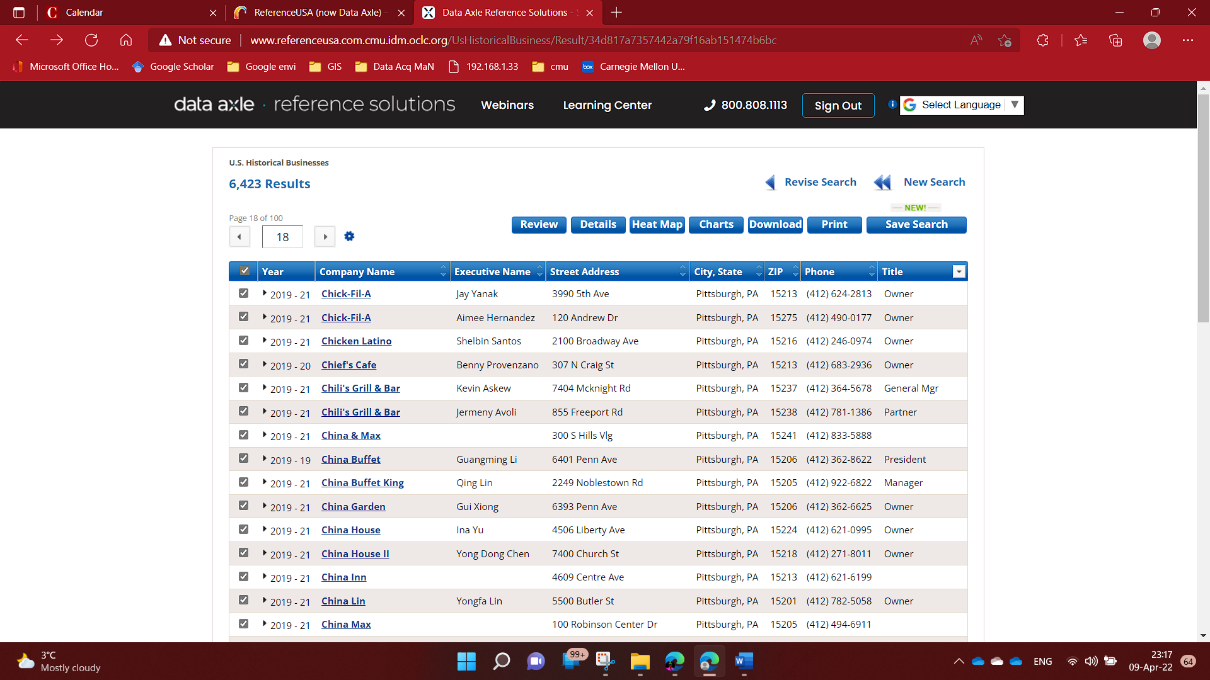
Data
US Historical Business Data
2019, 2020, 2021
Pittsburgh
Notes:
https://www.facebook.com/refusa/photos/a.112837635530670/1963116227169459

Slide 4
Cleaning & Processing Steps
Python3
ArcGIS Pro 2.8
Excel

Slide 5
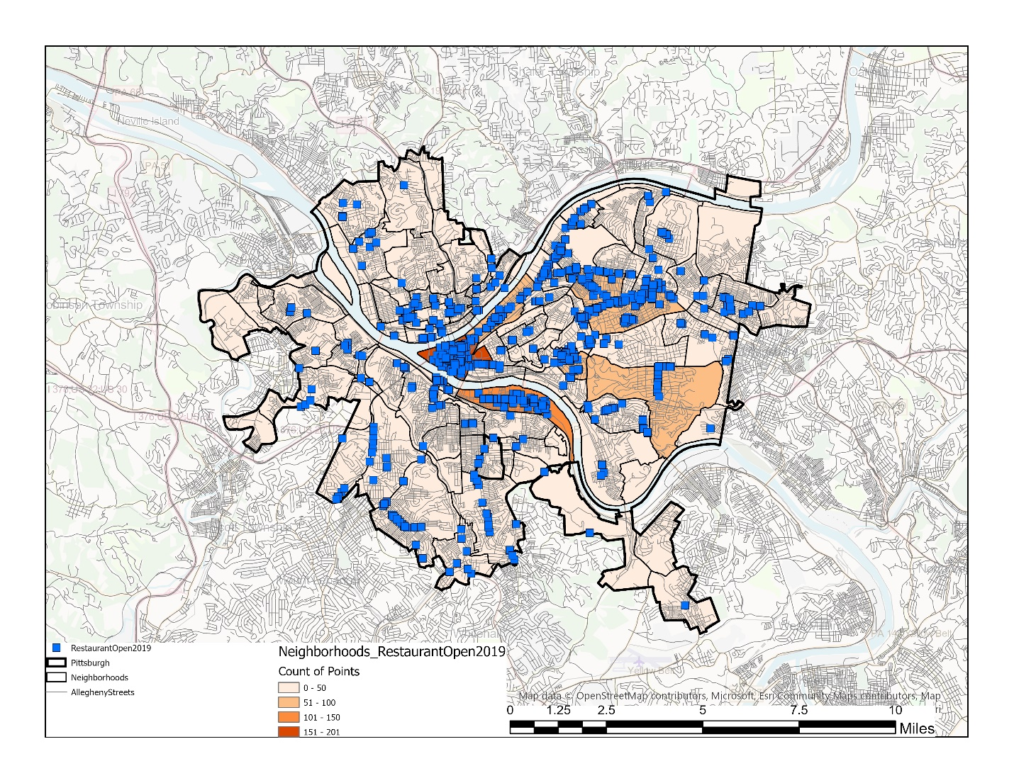
Remaining restaurants
2019

Slide 6
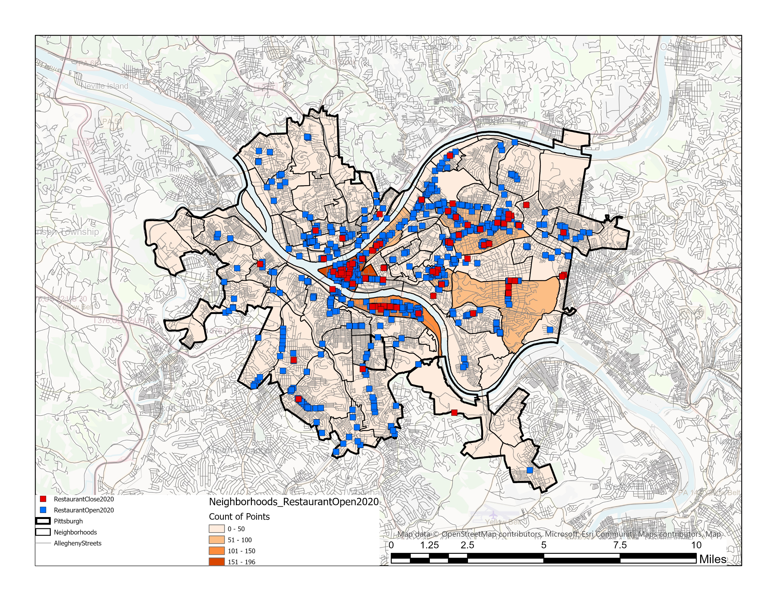
Remaining restaurants
2020

Slide 7
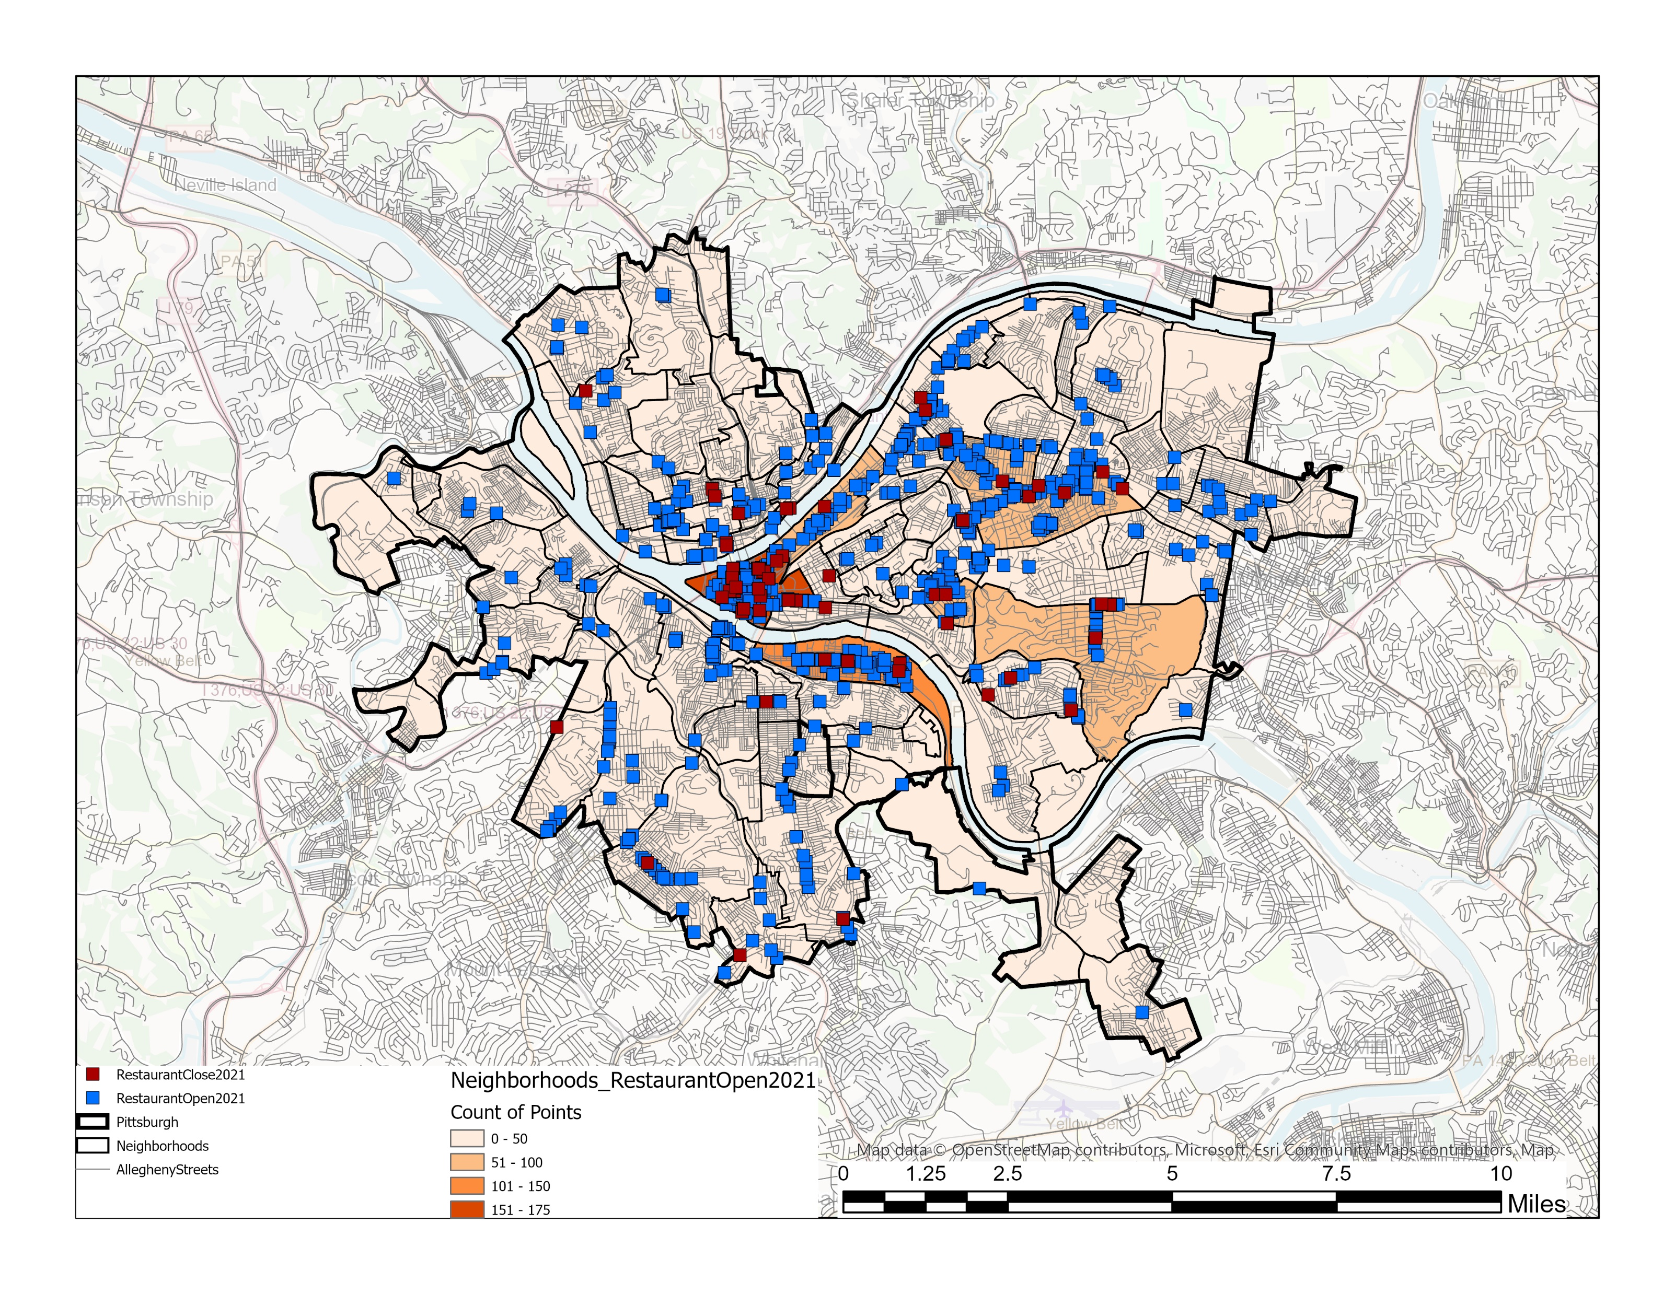
Remaining restaurants
2021

Slide 8
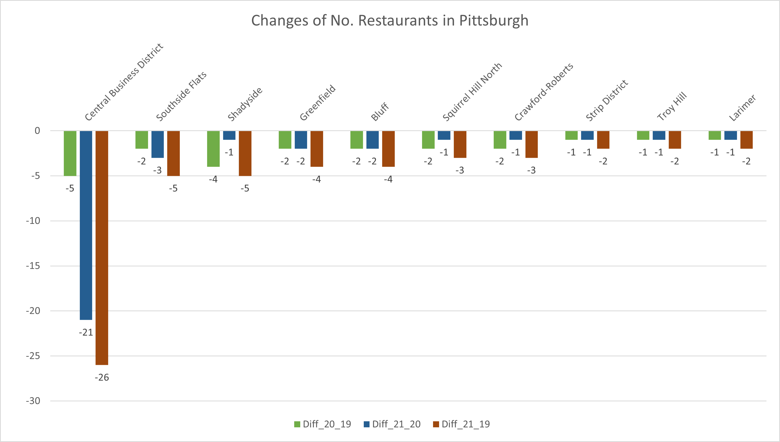
The changes

Slide 9
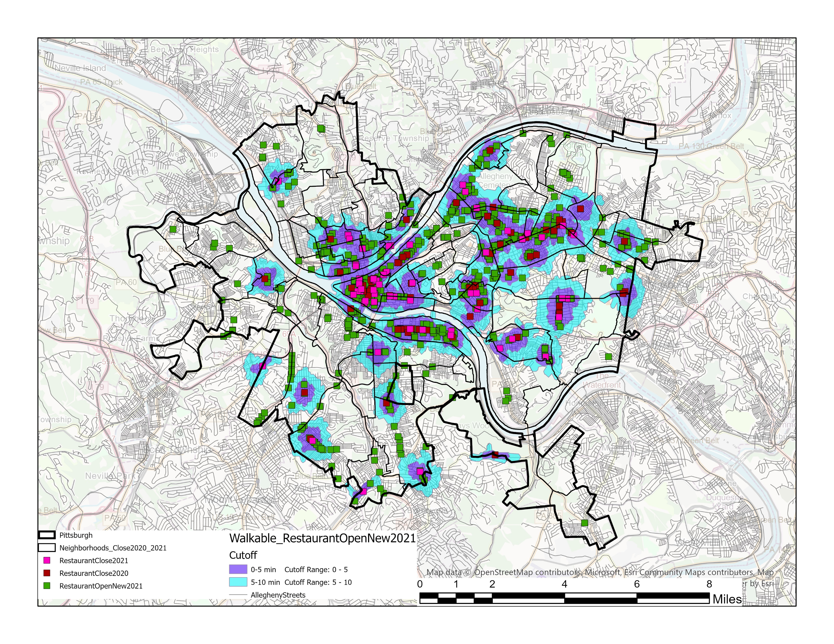
What can we learn from the closed restaurants?
Balance between high demands VS Competitors nearby

Slide 10
Conclusion
Most restaurants are in the CBD, Strip District, North & Central Oakland, Shadyside → very few in other areas.
The overall number of restaurants in Pittsburgh is now decreased.
By the number, CBD is the most affected area.
By the percentage, Crawford-Roberts and South Oakland are the most affected area
In terms of sidewalk network near the closed business, any restaurants within these areas must find a way to compete with others, specifically about 10 other places/ sq. mile of proximity.

Slide 11
Future Work
A survey of the reason of closure and the exact date of closure
Collection of how the restaurants is serving food such as dining-in, take home, or delivery via food applications (Uber Eat, Door dash, Grub Hub, in-house delivery)
Data from Google Map, TripAdvisor, Yelp, etc. can also filter out some places that may have other problems and not just COVID.

